Slide 1
Homeostasis Notes
Define homeostasis
Explain what is meant by the term Tolerance limits & tolerance ranges
State what the stimulus-response model is and how it maintains homeostasis
State what a negative feedback loop is
Name and define the different parts of a negative feedback loop
Explain how a negative feedback loop maintains homeostasis

Slide 2
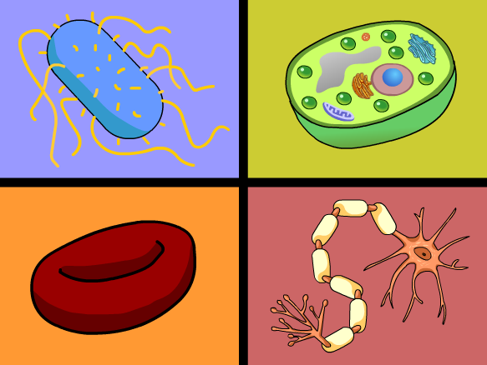
Homeostasis
Syllabus:
Homeostasis is the process by which the body maintains a relatively constant internal environment; it involves a stimulus-response model in which change in external or internal environmental conditions is detected and appropriate responses occur via negative feedback
Describe how the body maintains homeostasis by reducing a stimulus (negative feedback) using the stimulus response model
Essential
Question:
Recap:
What can you remember about the following from YR 11
Requirements for life
metabolism
enzymes

Slide 3
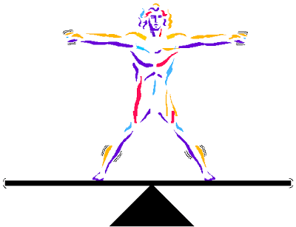
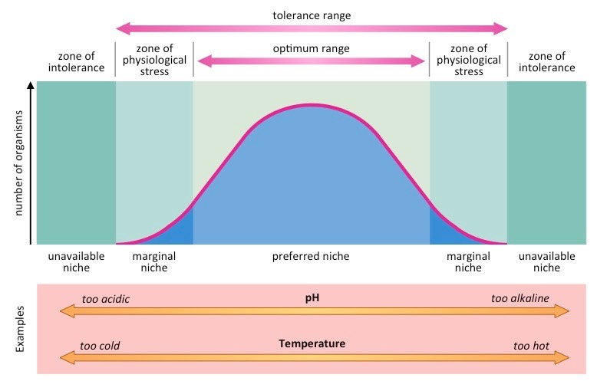
Topic Question 2: Define the terms tolerance limit and tolerance range
Topic Question 1:
Define the term homeostasis

Slide 4
Topic Question 3: Give examples of internal environmental factors that organisms need to keep within a range
Factor | Why the factor needs to be kept within a narrow range
Carbon Dioxide
Temperature
Salts
Water
Topic Question 4:
Using specific examples provide reasons why organisms need to keep environmental factors within narrow ranges

Slide 5
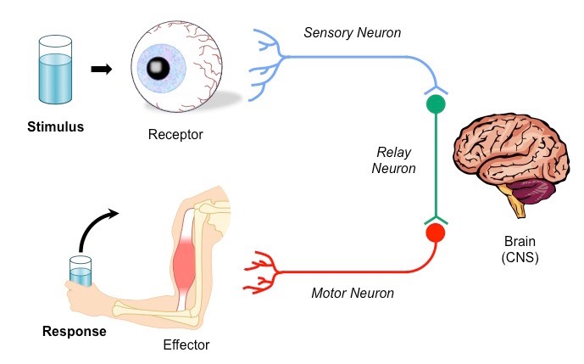
Topic Question 5: State how organisms maintain homeostasis
_________________, trauma, toxic substances and extremes in the internal and external environment can interfere with homeostasis
Responding to these changes and correcting them back to normal is essential so biochemical processes/pathways can be maintained.
The process of how this is achieved by organisms is referred to as a _____________ ______________
Two stages of homeostatic regulation:
1.
2.
This is called the ________________________________
Topic Question 6:
State the name of the model used to describe how organisms maintain homeostasis and the 2 stages of this model

Slide 6
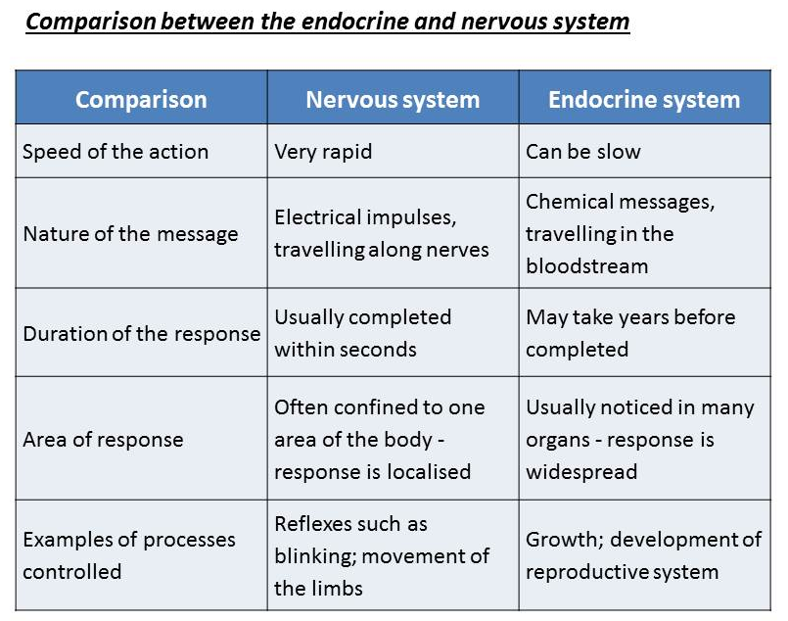
Topic Question 7:
State the systems involved in maintain homeostasis
Topic Question 8:
State how stimuli are detected in animals

Slide 7
Type of receptors | Stimuli | Location in animals
Chemoreceptor | (Internal receptors) Detect oxygen and ion levels | Aorta, carotid arteries
Osmoreceptor | (Internal receptors) Detect changes in osmotic pressure in blood (changes in blood water concentration) | Hypothalamus
Photoreceptor | (External receptors) Light | Eyes; light-sensitive cells on body surface of some invertebrates
Thermoreceptor | (External receptors) Detect external temperature variations | Skin
 | (Internal receptors) Detect internal temperature variations | Hypothalamus
Topic Question 9:
State the different receptors of animals and the stimuli they detect
Topic Question 10:
State how the nervous system maintains homeostasis

Slide 8
Topic Question 11:
State how the endocrine system maintains homeostasis
Endocrine gland | Hormone secreted | Target tissue/organ | Function related to homeostasis
Posterior pituitary |  | Kidney
Thyroid |  | Nearly all tissues
Negative Feedback
Positive Feedback
Topic Question 12:
Define the terms negative and positive feedback

Slide 9
Topic Question 13:
Name the parts of the negative feedback model and describe how each part works to maintain homeostasis
Part of model | Description of what it is & what it does…
Stimulus
Receptor
Coordinating centre (modulator)
Effector
Response
Negative feedback

Slide 10
Sum it up!
STIMULUS
Change in the environment that causes system to operate. (Above or below the normal).
RECEPTOR
Detects change
MODULATOR
Control centre responsible for processing information received from receptor & sending information to effector
FEEDBACK
Achieved because original stimulus has been changed by the response
RESPONSE
Action and processes (mechanism) of the effector
EFFECTOR
Carries out response counteracting effect of stimulus

Slide 11
Sum it up!
Homeostasis is the process by which the body maintains a relatively constant internal environment; it involves a stimulus-response model in which change in external or internal environmental conditions is detected and appropriate responses occur via negative feedback
Describe the importance of homeostasis & how the body maintains homeostasis
Syllabus:
homeostasis
maintain balance
keep within tolerance limit
stimulus response model
temp
water
positive feedback
negative feedback
salts
Metabolic waste
gases
Nitrogenous waste
Essential
Question:

